Slide 1
In-network Angle Approximation for Supporting Adaptive Beamforming
Hiba Mallouhi*, Jaspreet Kaur**, Hasan Tahir Abbas**, Sándor Laki*
* ELTE Eötvös Loránd University, Budapest, Hungary
** University of Glasgow, Glasgow, United Kingdom

Slide 2
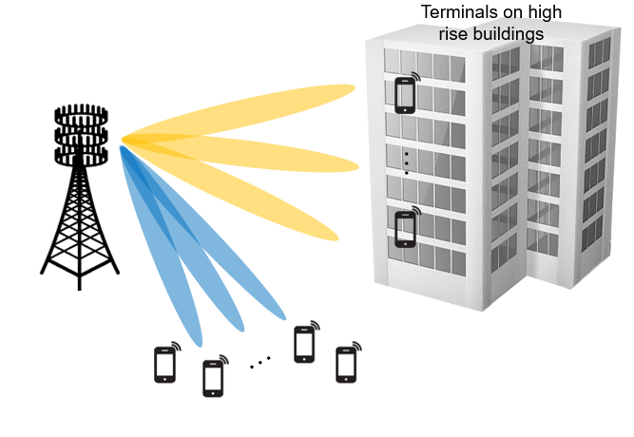
Beamforming
mmWave transmission in 5G
High propagation loss, signal blockage
Reduced distance
Beamforming
Extended communication range
Enhanced signal quality
Many advantages…
Beamforming direction is challenging
BS needs to determine the DOA of its users
Scanning-like approaches has high energy consumption
Other techniques has high computational complexities

Slide 3
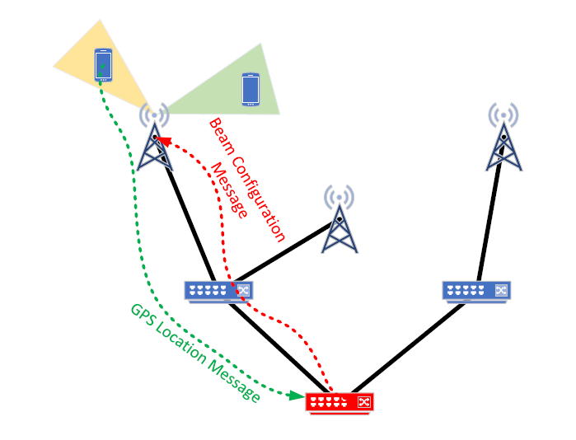
An User-Assisted Approach
UE reports it’s location
based on GPS or other sources
Processing inside the AAN
Messages handled as control packets
P4 switch assumption
Angle computation (or distance, etc.)
Generate configuration message to be sent to the BS
BS reconfigures the beam
According to new angle (and other) information

Slide 4
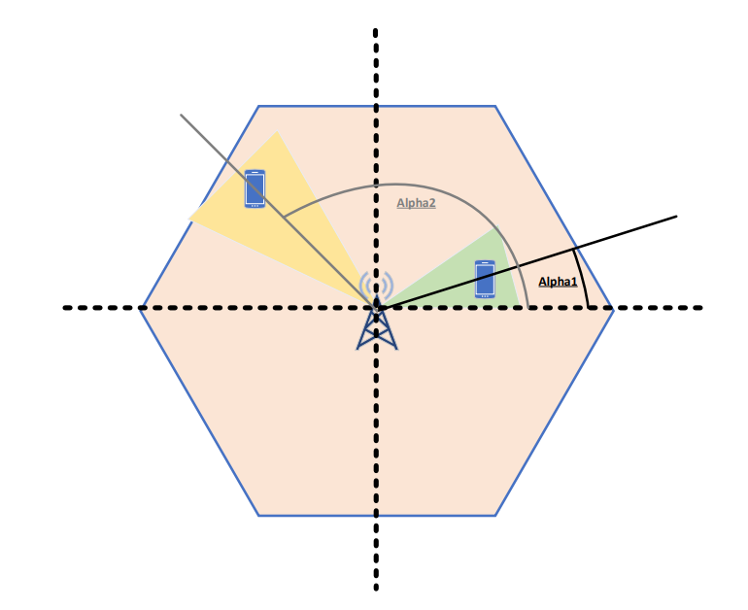
Angle computation is simple
UE coordinates: loc.x, loc.y
BS coordinates: bs.x, bs.y
$$=\left\{\begin{aligned}{\arctan\left(\frac{\left|loc.y−bs.y\right|}{\left|loc.x−bs.x\right|}\right) :loc.y>bs.y and loc.x>bs.x \atop π−\arctan\left(\frac{\left|loc.y−bs.y\right|}{\left|loc.x−bs.x\right|}\right) :loc.y>bs.y and loc.x<bs.x} \\ {π+\arctan\left(\frac{\left|loc.y−bs.y\right|}{\left|loc.x−bs.x\right|}\right) :loc.y<bs.y and loc.x<bs.x \atop 2π−\arctan\left(\frac{\left|loc.y−bs.y\right|}{\left|loc.x−bs.x\right|}\right) :loc.y<bs.y and loc.x>bs.x}\end{aligned}\right.$$
$$α$$

Slide 5
Angle computation is simple
UE coordinates: loc.x, loc.y
BS coordinates: bs.x, bs.y
…but, in P4?
$$=\left\{\begin{aligned}{\arctan\left(\frac{\left|loc.y−bs.y\right|}{\left|loc.x−bs.x\right|}\right) :loc.y>bs.y and loc.x>bs.x \atop π−\arctan\left(\frac{\left|loc.y−bs.y\right|}{\left|loc.x−bs.x\right|}\right) :loc.y>bs.y and loc.x<bs.x} \\ {π+\arctan\left(\frac{\left|loc.y−bs.y\right|}{\left|loc.x−bs.x\right|}\right) :loc.y<bs.y and loc.x<bs.x \atop 2π−\arctan\left(\frac{\left|loc.y−bs.y\right|}{\left|loc.x−bs.x\right|}\right) :loc.y<bs.y and loc.x>bs.x}\end{aligned}\right.$$
$$α$$

Slide 6
In P4? Preparation
Assuming Tofino-like capabilities
Constrained hardware
Pipeline packet processing with lookup tables
Location message from a UE
Special header format, coordinates and BS id
BS locations stored in a lookup table
Mapping BS id to coordinates
Absolute value of location difference and the sign of the difference
The signs determines the quarter around the BS

Slide 7
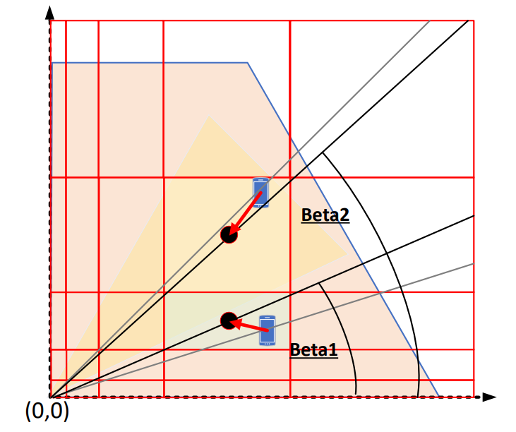
In P4? Computing arctan
Goal: $arctan\left(\frac{m.b}{m.a}\right)$
Grid-based approximation with exponential binning
The grid points on both axes are the same:
0, 𝐵¹ , 𝐵² , . . . , 𝐵^{𝑁} = 𝐷,
where 𝐵 is the base number,
𝑁 is the granularity factor (the number of bins on the axes)
while 𝐷 is the cell diameter (the maximum range)
Approx. based on the centroid point of the containing grid-cell

Slide 8
In P4? Computing arctan
Few properties
Desired accuracy determines the required TCAM space
Other parameters like power, signal strength can similarly be added in the future...
Customization of the table is also possible
Goal: $arctan\left(\frac{m.b}{m.a}\right)$
Grid-based approximation with exponential binning
The grid points on both axes are the same:
0, 𝐵¹ , 𝐵² , . . . , 𝐵^{𝑁} = 𝐷,
where 𝐵 is the base number,
𝑁 is the granularity factor (the number of bins on the axes)
while 𝐷 is the cell diameter (the maximum range)
Approx. based on the centroid point of the containing grid-cell

Slide 9
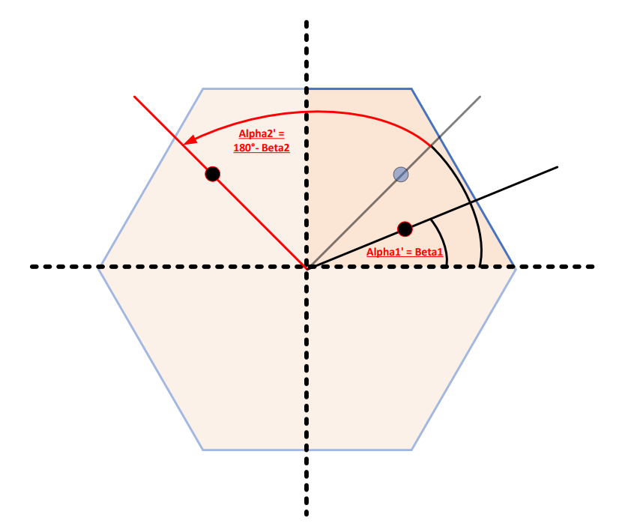
In P4? Final angle transformation
Signs determine the quadrant
$$=\left\{\begin{aligned}{\arctan\left(\frac{\left|loc.y−bs.y\right|}{\left|loc.x−bs.x\right|}\right) :loc.y>bs.y and loc.x>bs.x \atop π−\arctan\left(\frac{\left|loc.y−bs.y\right|}{\left|loc.x−bs.x\right|}\right) :loc.y>bs.y and loc.x<bs.x} \\ {π+\arctan\left(\frac{\left|loc.y−bs.y\right|}{\left|loc.x−bs.x\right|}\right) :loc.y<bs.y and loc.x<bs.x \atop 2π−\arctan\left(\frac{\left|loc.y−bs.y\right|}{\left|loc.x−bs.x\right|}\right) :loc.y<bs.y and loc.x>bs.x}\end{aligned}\right.$$
$$α$$

Slide 10
In P4? The whole pipeline
Implemented on Tofino-1 ASIC
Theoretical bound on the angle approximation accuracy
Accuracy vs TCAM space

Slide 11
Evaluation Approximation Error in static scenarios
Various cell diameters (D): 200-1000 meters
Various numbers of bins (N): 20-80

Slide 12
Evaluation Moving UE and control latency
UE moving at a constant speed
Control cycle
time from sending a location message to the reconfiguration of the beam at the BS
Loc msg
P4 switch
Control msg

Slide 13
Evaluation Moving UE and control latency
UE moving at a constant speed
Control cycle
time from sending a location message to the reconfiguration of the beam at the BS
Additional error
P4 switch

Slide 14
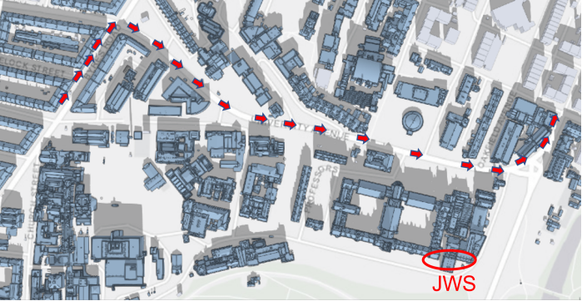
Evaluation Moving UE and control latency
UE’s speed: 5-200 kmph
Control cycle: 5-100ms
Simulation
Number of bins (N): 20
Diameter fixed: 800m

Slide 15
Evaluation Moving UE and control latency
UE’s speed: 5-200 kmph
Control cycle: 5-100ms
Simulation
Number of bins (N): 80
Diameter fixed: 800m

Slide 16
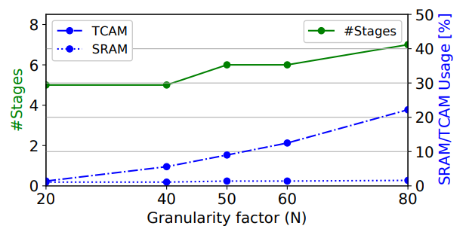
Evaluation Cost of accuracy
Predictable TCAM size
And stage number
Low SRAM usage

Slide 17
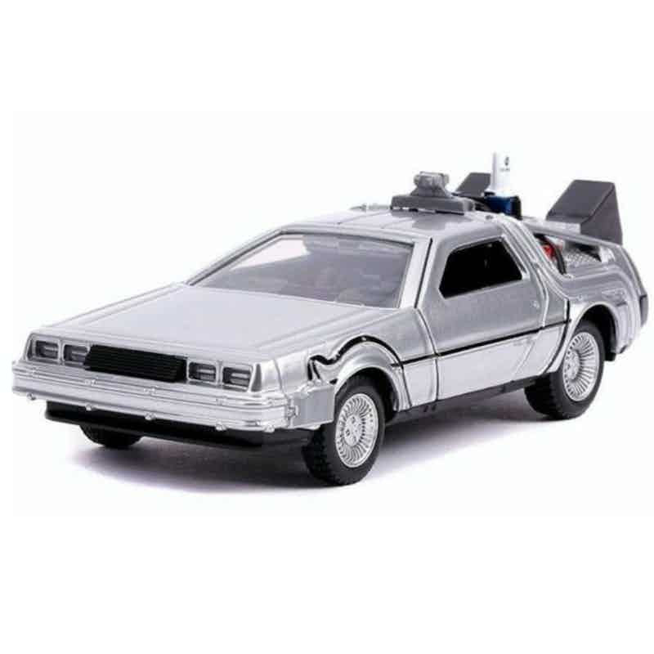
Conclusion & Future plans
In-network solutions results in low latency replies
Angle computation is complex but can be approximated
Bound on the accuracy
Requires moderate per-stage resources
Possibility to co-locate with other pipelines like 5G-UPF
Integration with a realistic radio propagation simulator
to quantify the effect of our method on channel quality
Efficient customization of angle prediction table
E.g., considering BS profiles

